Slide 1
Visa Page

Slide 2
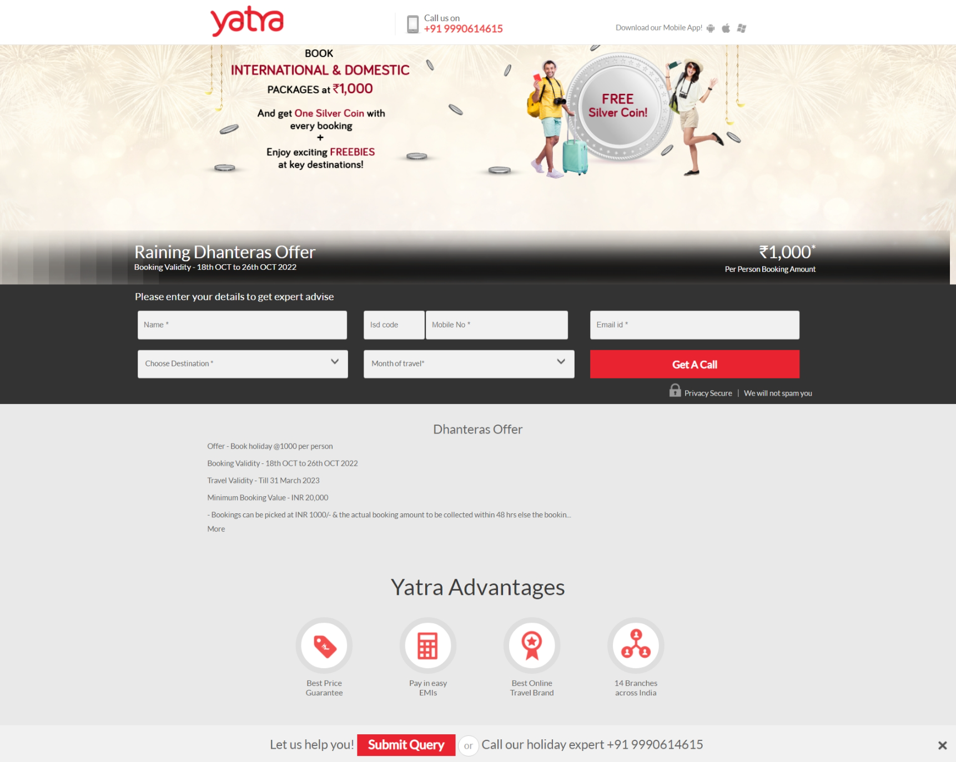

Slide 3
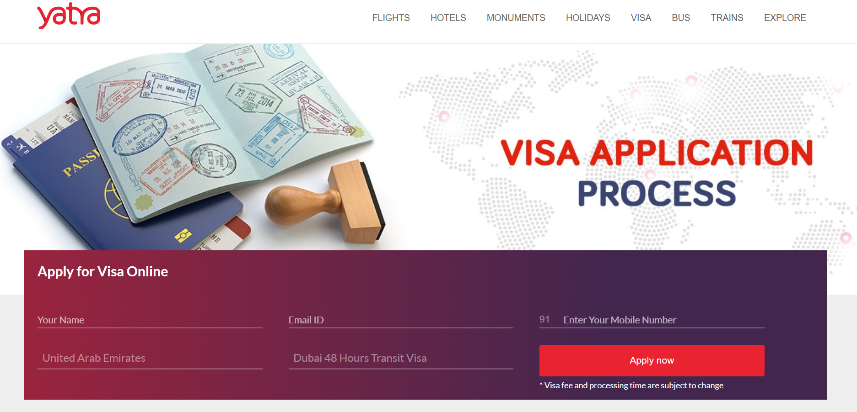
VISA APPLICATION
PROCESS
Apply for Visa invitation letter
Your Name--- Email Id---- Enter your Mobile Number--- Country where visa will applied--- India Medical Visa
*Visa Invitation letter is FREE from hospitals
Apply now

Slide 4


Rule and regulation to get Medical visa invitation letter
Send the old medical report and prescription for doctor’s opinion
Passport copy with at least 6 month expiry and 3 blank pages
Get Visa invitation letter from recognize Indian hospital
*NOTE: Marlin Medical Assistance never charge for Visa invitation letter. Its FREE from our side.
Marlin Advantages
Dedicated Support Team
Trusted Medical assistance brand
600+ hospitals across globe
Best Price Guarantee
Let us help you or call our medical tourism expert +91-8984 900 900
Submit Query

